Slide 1
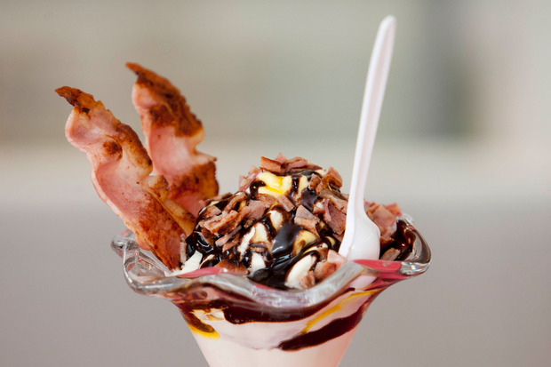
Burger King’s Bacon Sundae

Slide 2

Remember the brief you were given to develop your burgers ....
Design and make a creative and nutritious burger that will impress the judges for the in- house Carmel College Burger Competition.

Slide 3
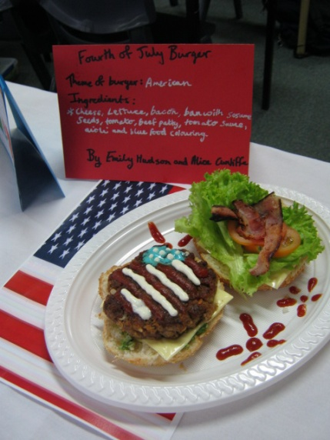
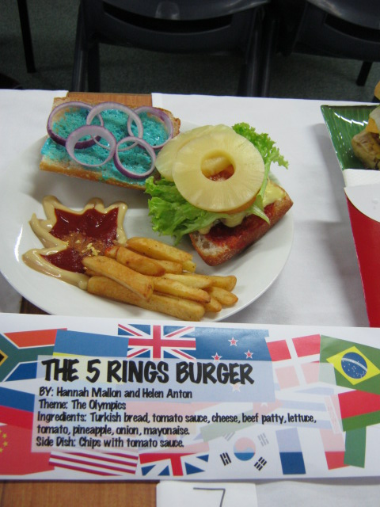
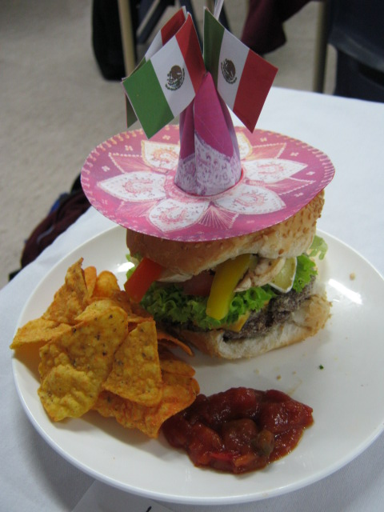
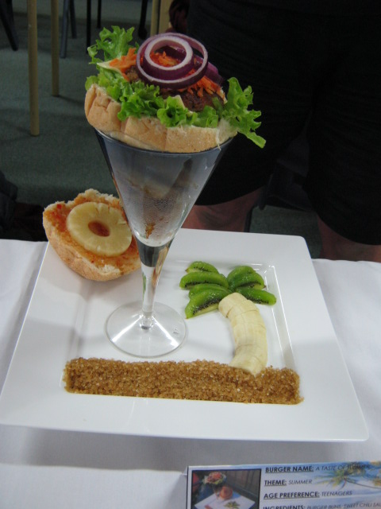
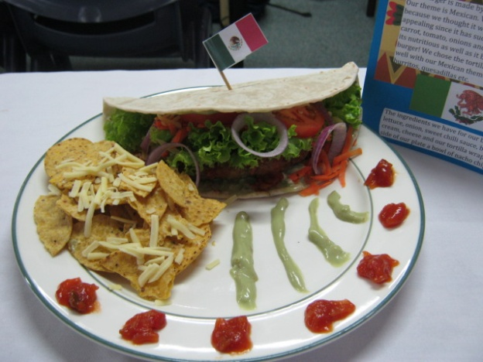
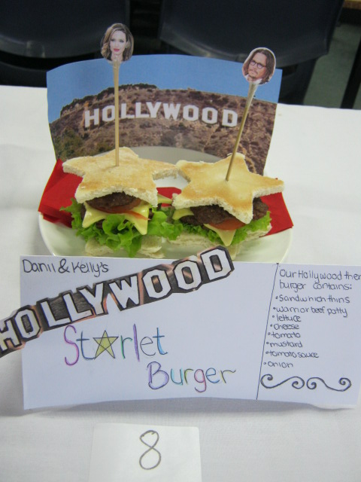
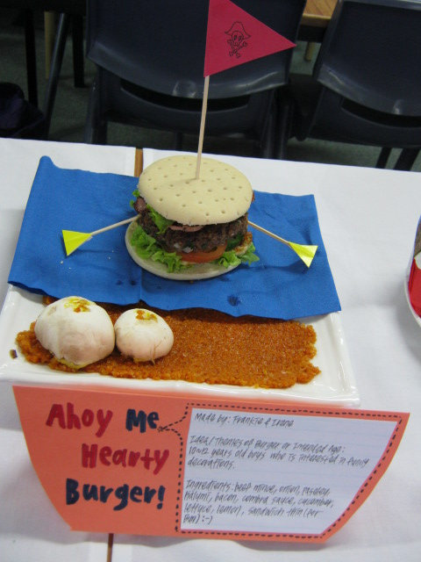
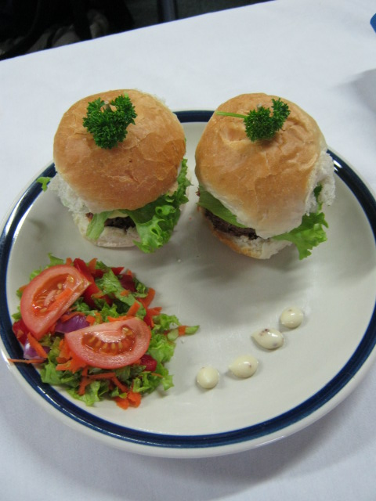
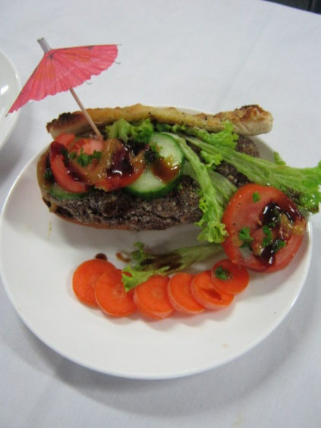

Slide 4
Learning intention:
Over the next three lessons we are going to develop the brief that Burger King gave to their Product Development Team when they developed the Bacon
Sundae.

Slide 5
A brief is made up of:
A need or opportunity
An outcome
Specifications (detailed attributes )
A conceptual statement that communicates what is to be done and why it should be done – by answering the questions who, what, why, when, where and how.

Slide 6
We know the outcome
We will identify the:
Need or opportunity
Specifications
Conceptual statement

Slide 7
Think, pair share activity
Would you buy this product? Why / why not?
Who are the intended users?
Why has this product been developed?

Slide 8
Product analysis of Bacon Sundae: To determine specifications

Slide 9
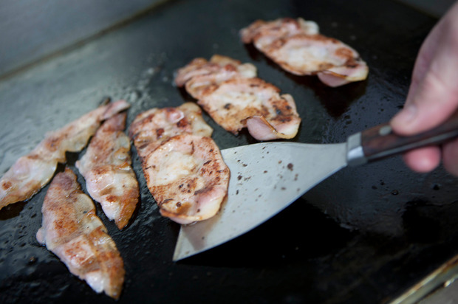
How do you make a bacon sundae?

Slide 10
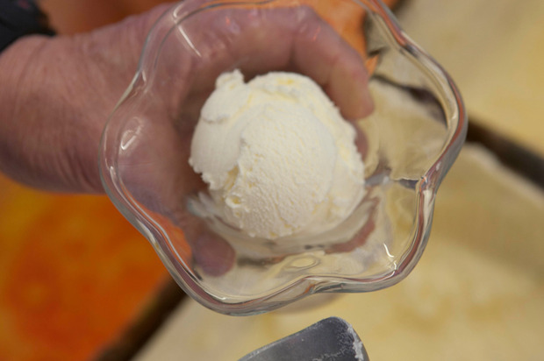
Ice cream

Slide 11
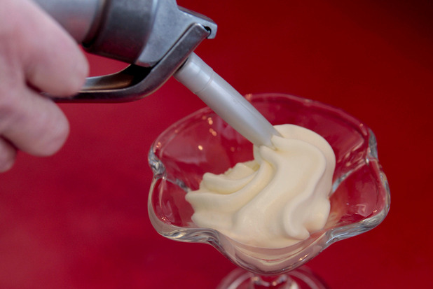
Whipped cream

Slide 12
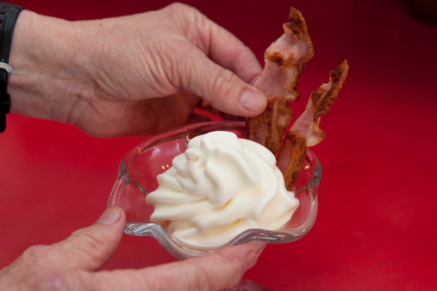
Bacon

Slide 13
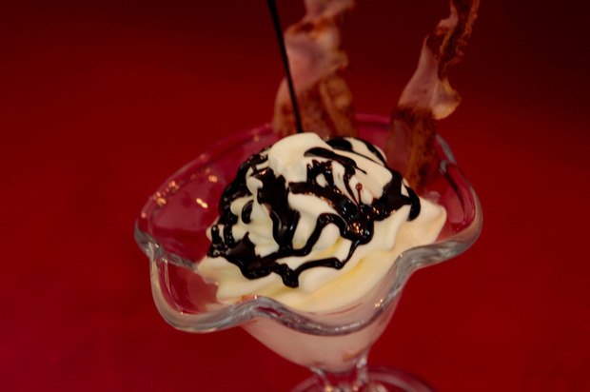
Chocolate and caramel sauce

Slide 14
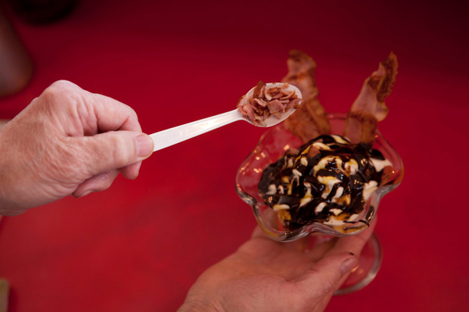
Bacon bits

Slide 15
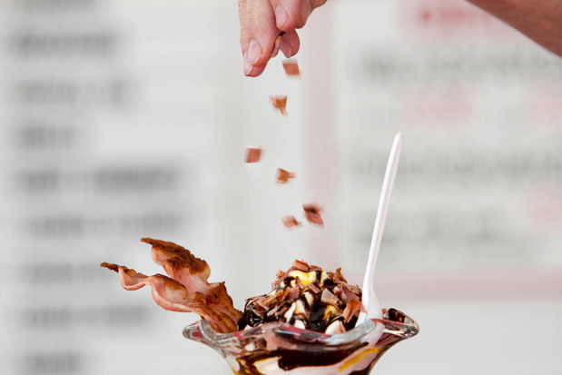

Slide 17
Identify the materials selected to make the Bacon Sundae
Ice cream
Bacon
Whipped cream
Chocolate sauce
Carmel sauce
Bacon bits

Slide 18
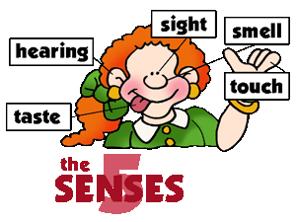
Materials (ingredients) used
Specifications
What performance properties (attributes) will each material have?
  Taste
  Flavour combinations
  Texture
  Temperature
  Visual
  Nutrition

Slide 19
Identify the functional and physical attributes of a bacon sundae and highlight them in two different colours.
Functional – how a product performs or “what it can do”
Physical – the products appearance or “what it looks like”

Slide 20
Practical: You made a bacon sundae
You completed a sensory analysis on a bacon sundae.

Slide 21
Describe how the performance properties (attributes)combine to ensure the materials allow the product to be fit for purpose
Taste
Texture
Temperature
Visual appeal
Ice cream and bacon flavours combine to.......
The textures of the...............combine to........
The hot and cold temperatures combine.............
Or the cold and cold temperatures ...........
The colours combine to.........

Slide 22
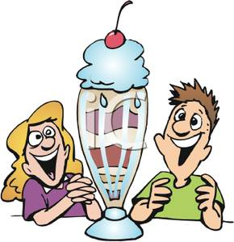
What are the specifications for Burger Kings’ bacon sundae?
The user
  Target market
  What will the user want from the product?

Slide 23
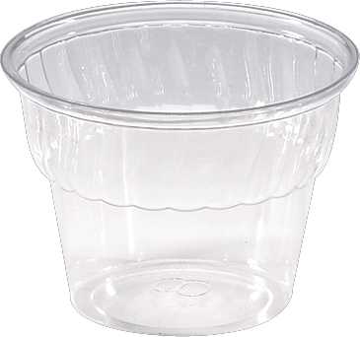
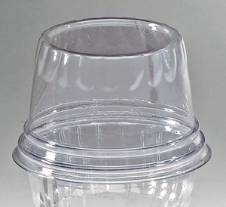
Moral, social and environmental issues
Packaging
Business environment

Slide 24
Do you think the materials (ingredients) chosen for this Bacon Sundae will make the product a success?
Justify your answer.

